Slide 1
Data Structure Examples
(demonstrations)

Slide 2
We’re going to cover…
Using a list to allow repetition
Replacing a selection with a list
Using a dictionary
Generating a multi-dimensional list (nested lists)

Slide 3
Worked Example
(revisited with a list)
Average
Project Name: average
Beginner
The code in Fig. 1 has been written to input 4 integer values, calculate the average of the 4 numbers inputted and then output the average of those values as a float.
num1 = int(input("Enter first integer: "))
num2 = int(input("Enter second integer: "))
num3 = int(input("Enter third integer: "))
num4 = int(input("Enter fourth integer: "))
avg = (num1 + num2 + num3 + num4) / 4
print("Average is: " + str(avg))

Slide 4
Worked Example
(replacing selection with a list)
Heads or Tails
Project Name: coin_toss
Beginner
Write a program that simulates the toss of a coin and asks the user to guess whether it was "Heads" or "Tails".
If the user guesses correctly, the program should output "You guessed correctly!", else the program should output "You guessed incorrectly".
if coin_toss == 1:
coin_toss_result = "Heads"
else:
coin_toss_result = "Tails"
if guess == coin_toss_result:
print("You guessed correctly")
else:
print("You guessed incorrectly")

Slide 5
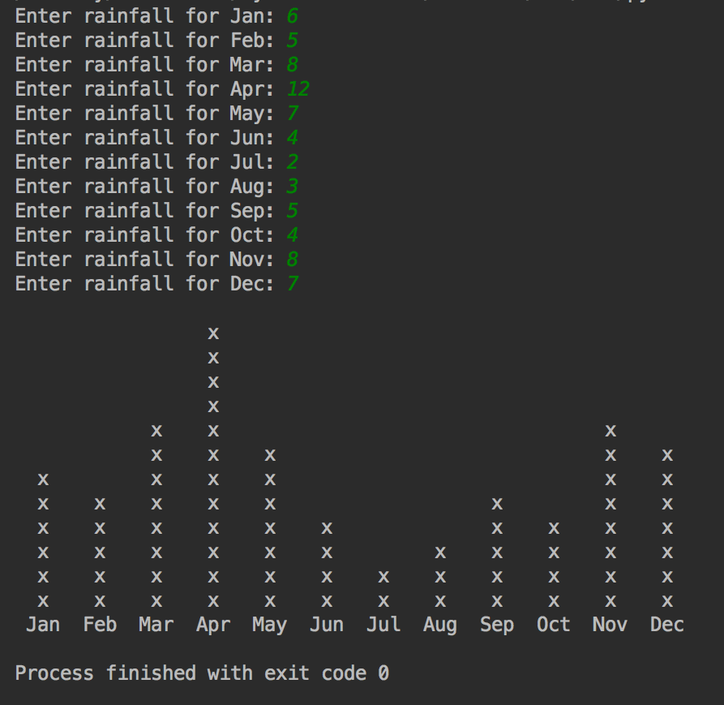
Worked Example
(dictionary example)
It never rains but it pours
Project Name: rainfall
Beginner
Write a program that prompts the user for the rainfall (in millimetres) for every month of the year. When your program has collected the data it should print out the results as a histogram.
Using the code from the lecture complete the Rainfall application so that it produces the histogram as illustrated below.

Slide 6
Worked Example
(multi-dimensional list)
Grid of Multiplication Tables
Project Name: multiplication_tables
Beginner
Write a program that calculates multiplication tables up to the ten times table. Your program should output the results as a grid (see below).
1 times table 1 2 3 4 5 6 7 8 9 10
2 times table 2 4 6 8 10 12 14 16 18 20
3 times table 3 6 9 12 15 18 21 24 27 30
4 times table 4 8 12 16 20 24 28 32 36 40
5 times table 5 10 15 20 25 30 35 40 45 50
6 times table 6 12 18 24 30 36 42 48 54 60
7 times table 7 14 21 28 35 42 49 56 63 70
8 times table 8 16 24 32 40 48 56 64 72 80
9 times table 9 18 27 36 45 54 63 72 81 90
10 times table 10 20 30 40 50 60 70 80 90 100

Slide 7
Any questions?

